Slide 1
Teaching Material for
Smart Cap
or
Improving current Emissions Trading Systems
by Larry Karp¹ & Christian Traeger^{2,3}
¹ ARE, UC Berkeley
² Economics, University of Oslo, Norway
³ ifo Institute for Economic Research, Germany
Notes:
US Global Change Research Program (2000), “Climate Change Impacts on the United States The Potential Consequences of Climate Variability and Change” (http://www.usgcrp.gov/usgcrp/Library/nationalassessment/overview.htm)
PEW 101

Slide 2
Background: CO2 Regulation
By 2023
47 national jurisdictions regulate
over 23% of global greenhouse gas emissions by either a
carbon tax (price regulation) or a
cap and trade system (quantity regulation with certificate trading)
(World Bank’s Carbon Pricing Dashboard 2023)
Following the Paris Agreement
88 countries consider/are in train of implementing either a tax or a cap and trade
At 2022 carbon prices
the European Emissions Trading System (ETS) has an annual market value of
around 150 billion USD, more than double its 2021 value
Notes:
Biggest in emissions currently being created in China
Singapore and South Africa about to introduce carbon taxes
EU ETS current market value of ~ 40 Billion USD, California regional ETS value of ~ 6.5 Billion USD

Slide 3
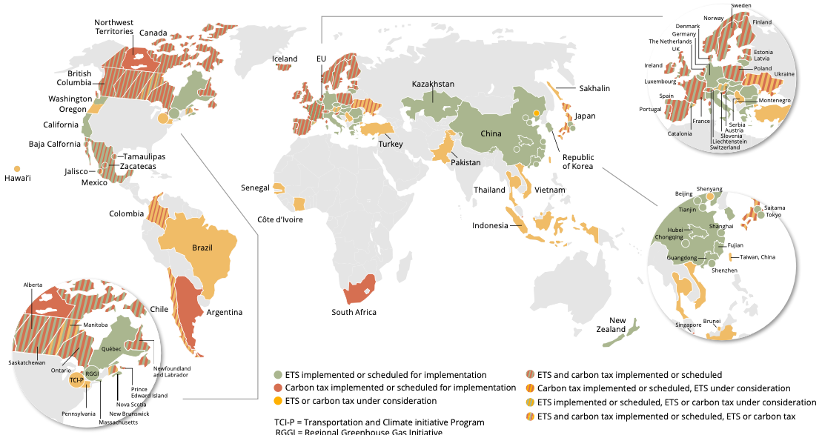
Carbon Pricing Around The World
Greenish: Emissions Trading. Redish: Carbon Tax. Striped: Both. Yellowish: under consideration.
The World Bank. 2021. “State and Trends of Carbon Pricing 2021” (May), World Bank, Washington, DC.
Notes:
The World Bank. 2021. “State and Trends of Carbon Pricing 2021” (May), World Bank, Washington, DC. Doi: 10.1596/978-1-4648-1728-1. License: Creative Commons Attribution CC BY 3.0 IGO

Slide 4
Background: Issues
Issues with current cap & trade systems
Prices dropped substantially and repeatedly as a result of
  Macroeconomic recession
  Unforeseen cost reductions including through technological progress
  Other factors including unexpected changes in fossil fuel provision
Slow policy (regulatory) response
  Slow regulatory process
  Inefficient measures like backloading in EU ETS (& issues with Market Stability Reserve)
Long-standing concern that taxes are more efficient than wide-spread cap & trade
As a result:
Cheap abatement left on the table during some periods
hefty price increases at short note during other periods
Notes:
Biggest in emissions currently being created in China
Singapore and South Africa about to introduce carbon taxes
EU ETS current market value of ~ 40 Billion USD, California regional ETS value of ~ 6.5 Billion USD

Slide 5
Some Insights in the Literature
When to use taxes or quantities?
Weitzman’s (1974) Prices vs Quantities: Static setting or ‘flow pollution’
-> taxes preferred if damage convexity < cost convexity
For stock pollutants such as CO2 and other greenhouse gases (e.g. Hoel & Karp (2001,2002), Pizer (2002), Newell & Pizer (2003), Karp & Zhang (2005), Fisher & Springborn (2011), Heutel (2012), Stavins (2020))
-> Find that taxes are more efficient
Hybrid policies: combine aspects of tax & cap:
Theory: How to reveal necessary information (e.g., Kwerel (1977), Dasgupta et al. (1980), Montero (2007), Kelly & Boleslavsky (2014))
-> First best or closer to first best in principle, but somewhat complicated
Practice: Cap & Trade combined with effective tax at price floor or ceiling (e.g. Roberts & Spence (1976), Weitzman (1978), Pizer (2002), Fell et al (2012))
-> Practical, but still inefficient
Moving towards a first best implementation:
Requate Unold (2001), Kollenberg & Taschini (2016), Karp & Traeger’s (2024) Smart Cap.

Slide 6
Overview of the Lecture
I. We introduce:
Smart tax: the optimal non-linear tax on emissions
Issue: all market participants have to observe aggregate emissions in real time
Smart cap: a practical mechanism to implement the optimal non-linear tax
  in a cap and trade framework
  accounting for the informational short-comings and delays
II. We discuss the case of stock pollutants and analyze
the optimal non-linear price-quantity relation (smart tax and cap)
how technology diffusion affects the slope of the smart tax
Extend Weitzman’s criterion for taxes vs quantities to the stock pollution setting:
-> compare smart tax slope (not damage convexity) to cost convexity

Slide 7
I - The Static World
Weitzman’s classic setting:
Firms emit a pollutant (E) realizing marginal benefits from emitting
Pollutant causes Marginal Social Damages (MD)
Regulator does not know firms’ benefits at the time of regulation
(either because of time delay of because of asymmetric information)
Note:
Marginal Benefits MB from emitting are equal to marginal abatement costs MAC
Assumptions:
Partial equilibrium setting with
Welfare = quadratic firm benefits - quadratic social damages
Leading to linear MD and marginal abatement cost (MAC) curves
Notes:
Issue with tax:
Central real time emission monitoring required
Politically Cap & Trade preferred
Individual firm is ignorant of aggregate expected emissions

Slide 8
I - The Static World
Social optimality equates
Marginal damages (MD) = Marginal benefits from emitting (or MAC)
Solid: expected MAC realization; Dashed: other possible MAC realizations
Marginal Benefits
from Emitting (MAC)
Price
Marginal Damages from Emitting
Optimal Allocation at high
MB realization
p*(E)
Optimal Allocation at expected
MB realization
Optimal Allocation at low
MB realization
MAC’’
MAC’
Emissions E
Notes:
Issue with tax:
Central real time emission monitoring required
Politically Cap & Trade preferred
Individual firm is ignorant of aggregate expected emissions

Slide 9
I - The Static World: Tax vs Cap
Observe: Flatter MD curve
-> Lower Welfare Loss under Tax
Price Regulation (Tax):
MB = Marginal
Benefits from Emitting
Market Equilibrium Cap
Price
MD = Social Cost of Carbon
Welfare Loss under Cap
Optimal Allocation
at high MB realization
Welfare Loss under Tax
Tax
Market Equilibrium Tax
Higher than expected
MB realization
Cap
Emissions

Slide 10
I - The Static World: Tax vs Cap
Weitzman (1974) “Prices vs. Quantities”:
Setting:
Static or Flow Pollution
Pollutant only affects consumer welfare during period of emitting
Finding: Whenever
marginal damages from emissions (MD)
less steeply sloped than
marginal benefits from emitting (MB) (=abatement cost)
A tax implies lower welfare losses from uncertainty than cap and trade
Common argument:
MD from CO2 (the Social Cost of Carbon) is very shallow, so tax better
But: Not a flow pollution problem
Notes:
UPDATE

Slide 11
I - The Static World: Hybrid
Regulator commits to buy (floor) and sell (ceiling) certificates to maintain price in bounds
Hybrid System:
MB = Marginal
Benefits from Emitting
Price
MD = Social Cost of Carbon
Safety Valve (=high tax)
p*
Welfare Loss Hybrid
Standard Cap Region
Price Floor (=low tax)
MAC’’
q*
Emissions
Notes:
e.g. Burtraw et. al (2010), Fell et. Al (2012)

Slide 12
I - The Static World: The Smart Tax
“SMART TAX” in static setting:
A non-linear tax equal to Marginal Damages
red line
Marginal Benefits
from Emitting (MAC)
Price
Marginal Damages from Emitting
Optimal Allocation at high MB realization:
Market Equilibrium
if red line=smart tax
p*(q)
Optimal Allocation at low MB realization:
Market Equilibrium
if red line=smart tax
MAC’
MAC’’
Emissions q
Notes:
Issue with tax:
Central real time emission monitoring required
Politically Cap & Trade preferred
Individual firm is ignorant of aggregate expected emissions

Slide 13
I - The Static World: Issues with The Smart Tax
Individual firm has little information about aggregate emissions and, thus,
expected price when taking its production decision
Politically cap & trade seems preferred
Marginal Benefits
from Emitting (MAC)
Price
Requate & Unold (2001):
Suggest implementing a “staircase” approximation
in a cap and trade system
using options
Great idea
Problematic if prices move up and down due to repeated shocks
MD
p*(q)
MAC’
MAC’’
Emissions q
Notes:
Issue with tax:
Central real time emission monitoring required
Politically Cap & Trade preferred
Individual firm is ignorant of aggregate expected emissions

Slide 14
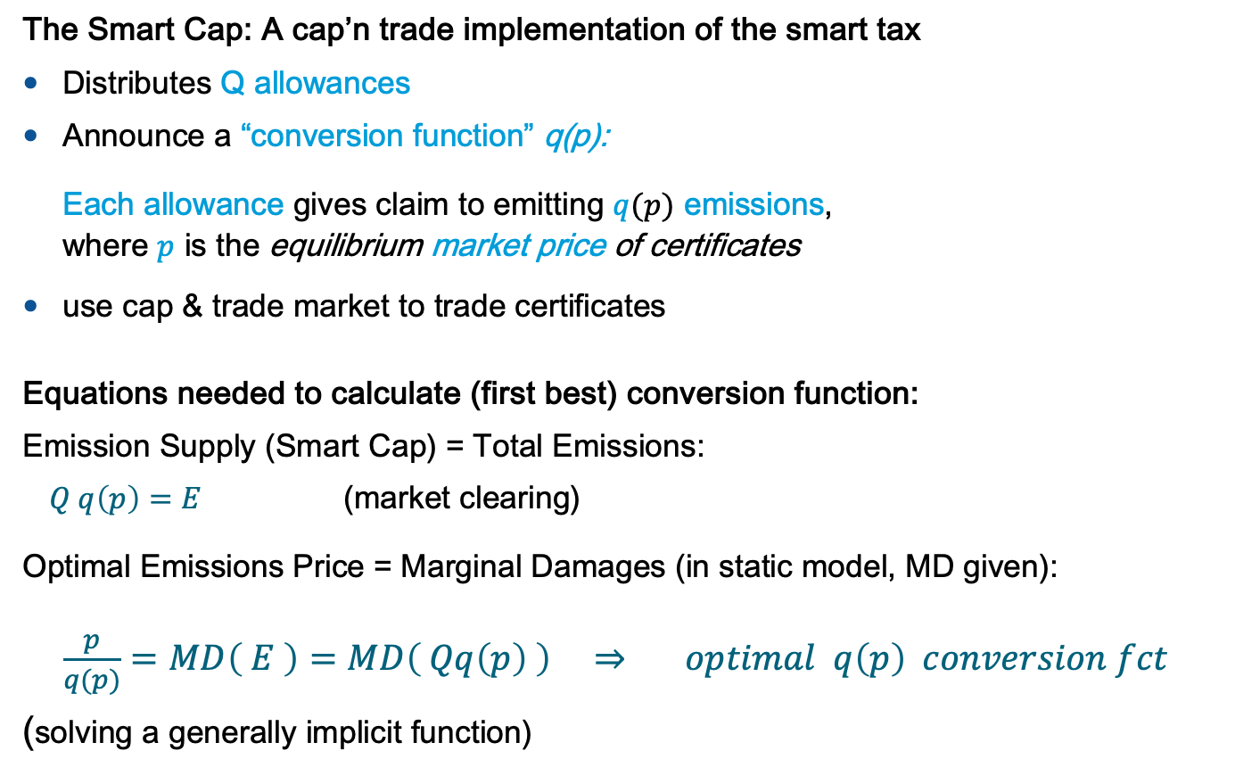
I - The Static World: The Smart Cap
The Smart Cap: A cap’n trade implementation of the smart tax
Distributes Q allowances
Announce a “conversion function” q(p):
Each allowance gives claim to emitting $q(p)$ emissions,
where $p$ is the equilibrium market price of certificates
use cap & trade market to trade certificates
Equations needed to calculate (first best) conversion function:
Emission Supply (Smart Cap) = Total Emissions:
$Q q\left(p\right)=E$ (market clearing)
Optimal Emissions Price = Marginal Damages (in static model, MD given):
$\frac{p}{q(p)}=MD\left( E \right)=MD\left( Qq\left(p\right) \right) ⇒ optimal q\left(p\right) conversion fct$
(solving a generally implicit function)

Slide 15
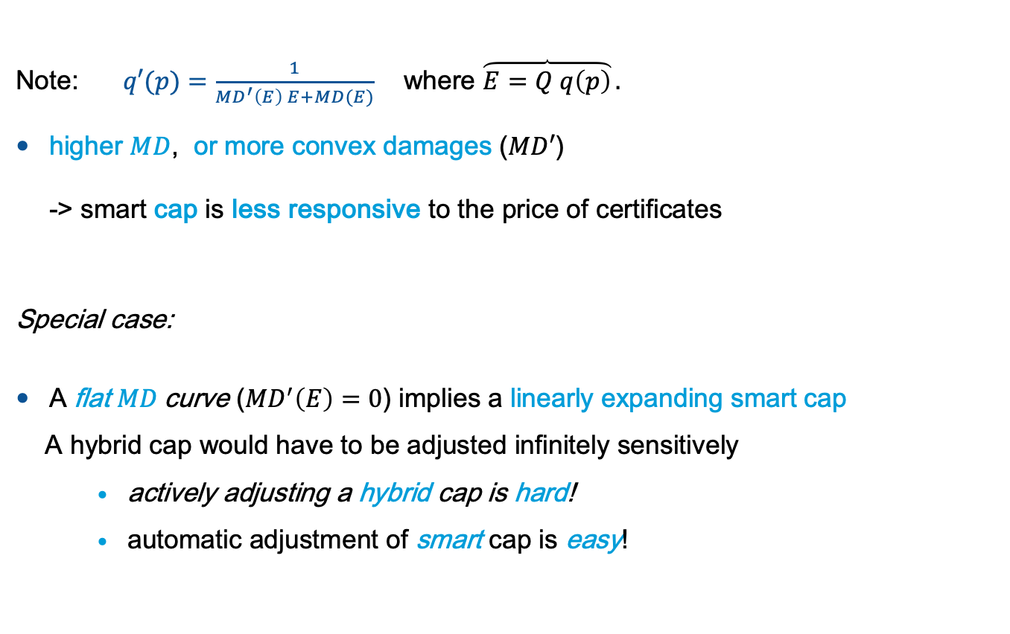
I - The Static World: The Smart Cap
Note: $q′(p)=\frac{1}{{MD}^{′}\left(E\right) E+MD(E)}$ where $\overbrace{E=Q q\left(p\right)}.$
higher $MD$, or more convex damages ($MD′$)
-> smart cap is less responsive to the price of certificates
Special case:
A flat $MD$curve (${MD}^{′}\left(E\right)=0$) implies a linearly expanding smart cap
A hybrid cap would have to be adjusted infinitely sensitively
    actively adjusting a hybrid cap is hard!
    automatic adjustment of smart cap is easy!
Smart Cap
Notes:
Emissions price to be constant. If certificate price increases I have to allow more emissions per certificate to keep price constant
Consider expressing in paper also for normalizing in terms of a=1.
Second special case
For ${MD}^{′}\left(E\right)→∞$ cap is irresponsive to price (standard cap)

Slide 16
II.1 - Dynamic World: Intuition (smart tax)
Intuition: Assume a green technology innovation
Lowers abatement costs and thus MB curve, thereby
Reducing future equilibrium emissions, thereby
Reducing marginal damages of a ton of CO2 emitted today
-> The shift of the MAC curve implies a correlated shift of the MD curve!
Price
MB or MAC
MD = Social Cost of Carbon
Optimal Allocations
MD curve
Is no longer policy benchmark
(precisely: None of the MD curves)
Slope relative to MB curve is
no longer tax vs quantity
efficiency measure
Related: Stavins (1996), Weitzman (1974): correlated shocks to MD and MB curve
Emissions

Slide 17
II.1 - Dynamic World: Intuition (smart tax)
Other scenarios:
Left: Gentle slope of MD curve, yet cap and trade delivers first best
Right: Optimal nonlinear tax “Price(Emissions)” can even slope down
Can these scenarios really happen? What can we say quantitatively?
Price
Optimal
Price
MB
MB
MD = SCC
MD = SCC
Optimal
Emissions
Emissions
Notes:
Can these happen in full model?

Slide 18
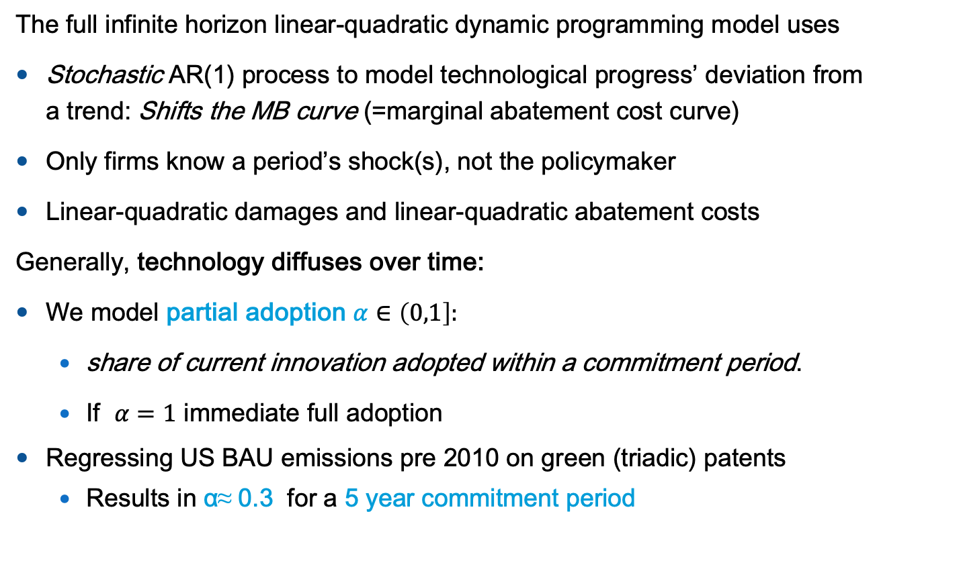
II.2 - Dynamic World: Linear Quadratic Model
The full infinite horizon linear-quadratic dynamic programming model uses
Stochastic AR(1) process to model technological progress’ deviation from
a trend: Shifts the MB curve (=marginal abatement cost curve)
Only firms know a period’s shock(s), not the policymaker
Linear-quadratic damages and linear-quadratic abatement costs
Generally, technology diffuses over time:
We model partial adoption $α∈\left(0,1\right]:$
  share of current innovation adopted within a commitment period.
  If $α=1$ immediate full adoption
Regressing US BAU emissions pre 2010 on green (triadic) patents
  Results in α≈ 0.3 for a 5 year commitment period
Notes:
Emissions price to be constant. If certificate price increases I have to allow more emissions per certificate to keep price constant
Consider expressing in paper also for normalizing in terms of a=1.

Slide 19
II.2 - Dynamic World: Theoretical Results Smart Tax
Assumption: Convex damages (positive slope of MD curve)
and positive technology persistence
Proposition 1: Under immediate full adoption of technological innovation (α=1)
the smart tax always has a positive slope
the smart tax increases more steeply in present emissions
than the SCC (SCC for any given shock realization)
Proposition 2 (general α): For any well-defined model specification
exists α^{crit} in (0,1) such that the slope of the smart tax is
  vertical at α = α^{crit} -> standard cap is first best
  positive for α > α^{crit} and steeper than the slope of SCC
  negative for α < α^{crit} .
Under mild conditions (see paper’s Proposition 2) and assuming a tâtonnement process:
The smart tax supports the optimal emission level as a globally stable competitive equilibrium.
Notes:
For prop 1 second statement implies first…

Slide 20
II.2 - Dynamic World: Theoretical Results
Proposition 4 (Smart Cap) :
If α > α^{crit} (smart tax has positive slope), then
the conversion function (formula see paper) implements the
first-best emission level as a stable competitive equilibrium.
The redemption function increases in the certificate price.
If α < α^{crit} (smart tax has negative slope), then
the conversion function (formula see paper) implements the
first-best emission level as a stable competitive equilibrium on a limited domain. The redemption function falls in the certificate price.
More generally, the smart cap is stable if the smart tax is increasing in emissions, and it is stable if the smart cap is decreasing in the certificate price (Proposition 2).
Proposition 5 (Extension of Weitzman’s ranking criterion to stock pollutants) :
With stock pollutants, (standard) taxes welfare-dominate (standard)
quotas if and only if the slope of the smart tax is less than the slope of the marginal abatement cost.
Notes:
For prop 1 second statement implies first…

Slide 21
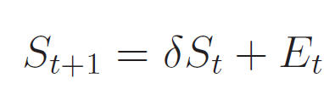


Quantification
Climate: we use the TCRE model:
Temperature is proportional to cumulative historic emissions (IPCC 2013)
Even if approximation, better temperature dynamics than DICE (before 2023 version)
: , are cumulative emissions/temperature and =1
Damage:
Baseline scenario: calibration to DICE’s 1% damage at 2C warming
Concerned scenario: no damages at current 1C, 5% at 3C (more convex)
Technology:
Assumption: technological innovation is fully persistent : ρ=1
We vary adopted share α of innovation during 5 year commitment period:
Abatement cost (or benefit of emissions)
Calibrated to DICE (and falling over time), see paper
Time preference: Annual rate of pure time preference of 1.5% (variation with 0.5%).
Note: LQ partial equilibrium model w/o baseline growth
Notes:
For prop 1 second statement implies first…

Slide 22
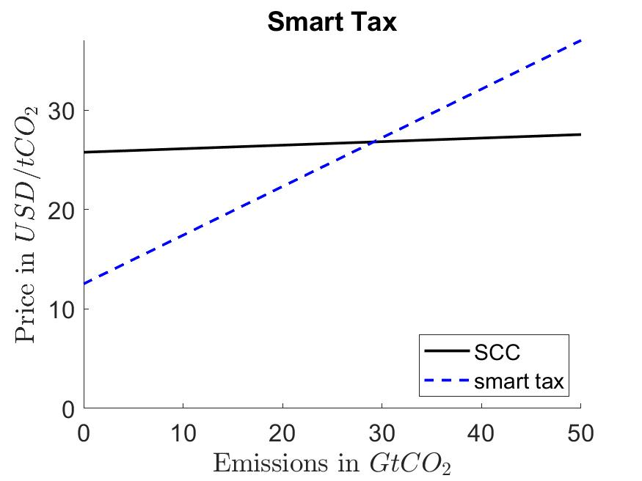
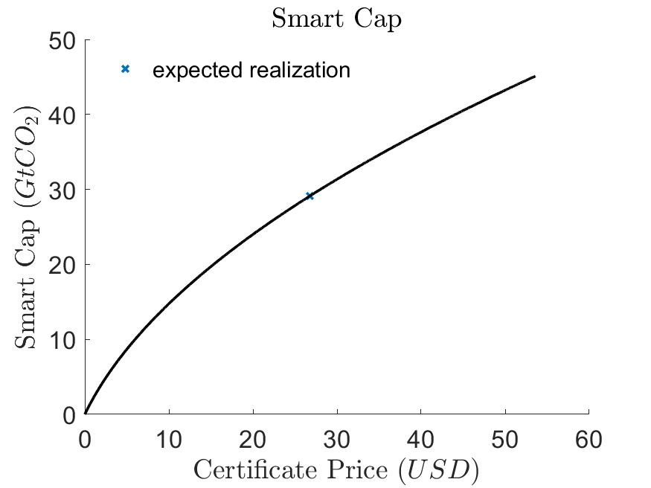
II.3 - Dynamic World: Quantitative Results
1. Immediate Full Adoption of Technological Innovation (α=1):
Notes:
The SCC line in the smart tax graph assumes expected realization
(for other realizations it shifts up and down keeping the slope)
The smart cap graph depicts total cap (Q*Conversion Fct). It assumes:
certificate number Q = optimal emissions under expected realization
Notes:
For prop 1 second statement implies first…

Slide 23
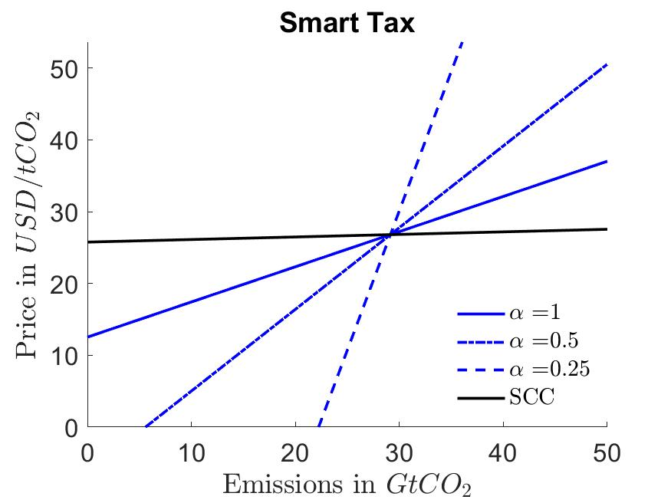
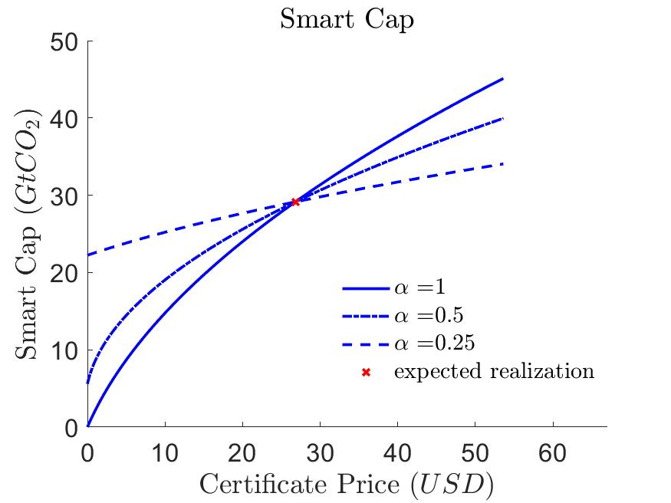
II.3 - Dynamic World: Quantitative Results
2. Partial Adoption of Technological During Commitment Period
with partial adoption during the commitment period:
Smart tax becomes steeper: Price more responsive to quantity change
Smart cap becomes less responsive: Quantity becomes less responsive
Lower adoption share α(more delayed adoption) makes standard “fix” (or dumb ☺) cap more attractive. Intuition: Future technology adoption increases SCC shift.
Notes:
For prop 1 second statement implies first…

Slide 24
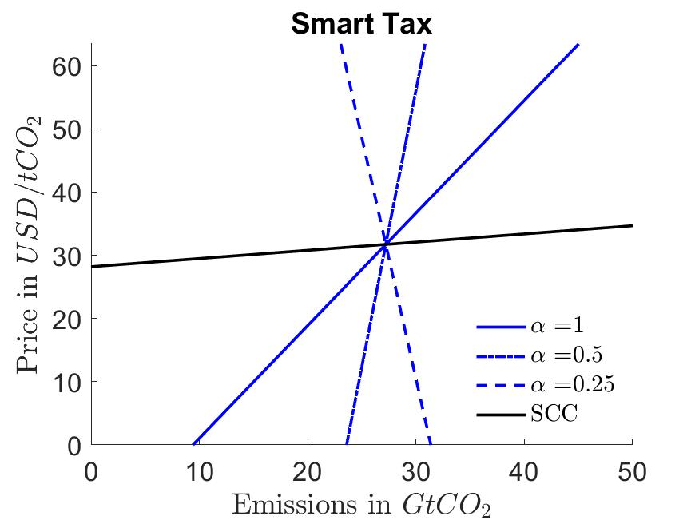
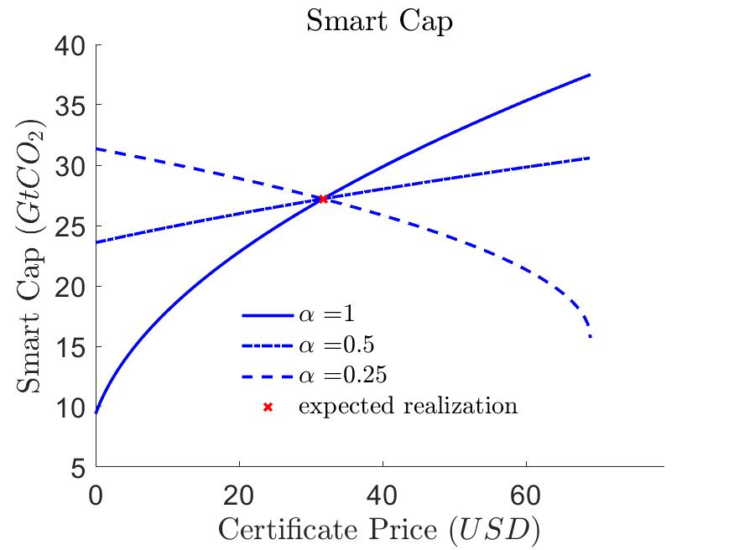
II.3 - Dynamic World: Quantitative Results
3. The “concerned” scenario: More convex damages:
Here with α= 0.25 smart tax and redemption function are decreasing.
Both policy instruments still result in stable competitive equilibria.
Here a better than expected green realization lowers future emissions and, thus, SCC more than it lowers current marginal abatement costs.
As a result firms are allowed to emit more if price falls
Here, a standard cap is better than a standard tax.
Notes:
For prop 1 second statement implies first…

Slide 25
III.4 Further Comments
Market Power:
If a smart cap q (p) is designed for full competition:
Monopsonist exercises market power by reducing level of emissions below first best if and only if slope of corresponding smart tax is positive.
The policy maker can induce an optimal emission allocation using a smart cap designed for market power.
Smart cap offers an “optimal political compromise”:
Firms are better protected from too high price shocks
Social/Environmental concern better protected from too low a carbon price

Slide 26
III.4 Banking & European Market Stability Reserve
Banking and interperiod trading of Certificates:
A common mechanism to smooth shocks in cap and trade systems
is to allow for banking of certificates from one period to the next
Works only if it is optimal to bank (borrowing is difficult for liability reasons)
Smart Cap includes its own mechanism for smoothing shocks,
so banking is not required but can be combined if desired
Comparison to EU ETS market stability reserve (MRS):
MRS & Smart Cap can both be used to counteract low certificate prices
MRS achieves reduction by canceling banked certificates
MRS thereby reduces the shock smoothing response of a classical cap and trade system by limiting the effectiveness of banking
By contrast a Smart Cap increases the shock-smoothing response

Slide 27
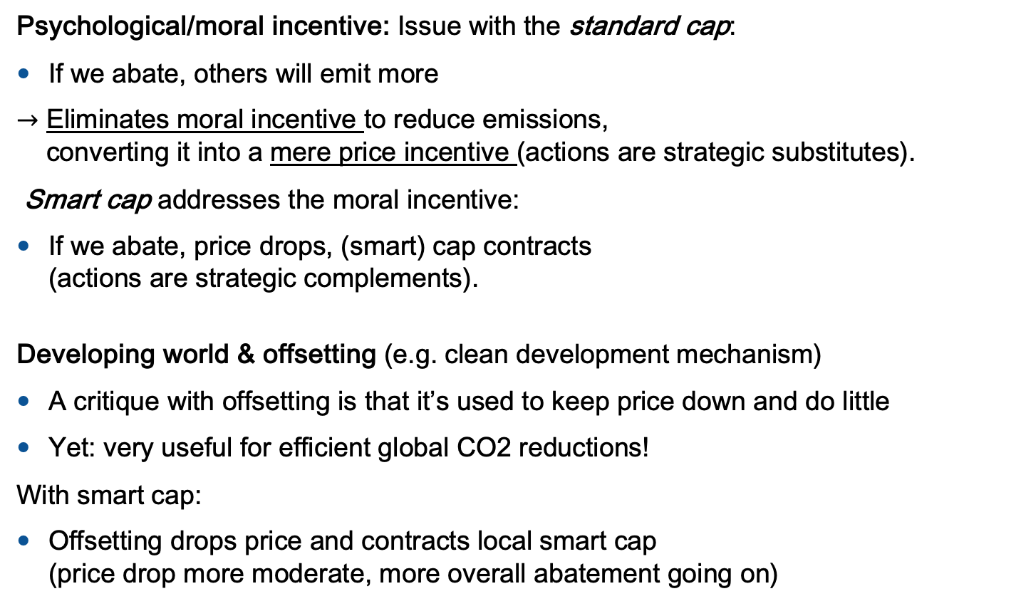
III.4 More on incentives
Psychological/moral incentive: Issue with the standard cap:
If we abate, others will emit more
$→$ Eliminates moral incentive to reduce emissions,
converting it into a mere price incentive (actions are strategic substitutes).
Smart cap addresses the moral incentive:
If we abate, price drops, (smart) cap contracts
(actions are strategic complements).
Developing world & offsetting (e.g. clean development mechanism)
A critique with offsetting is that it’s used to keep price down and do little
Yet: very useful for efficient global CO2 reductions!
With smart cap:
Offsetting drops price and contracts local smart cap
(price drop more moderate, more overall abatement going on)
Notes:
No speculative attack – but then again other than pound and Bretton Woods, certificates are finite so not sure how promising to bet on price underneath floor against a government

Slide 28
III.4 Practical Points regarding Implementation
Trading “certificates” rather than “tons of CO2”:
Similar to existing ITQs in fishery (Individual transferable fishing quotas)
There we trade shares of a (fish-) pie whose size is directly set by policy maker
Here: trade shares of a (carbon-) pie whose size is endogenously set by the market
For major markets arbitrageurs can/will offer “ton CO2 certificates/derivatives”
EU requires unanimity rules for price instruments:
smart cap remains a quantity regulation, yet even more efficient than a tax
In case trading a “non-ton” still politically infeasible:
Use previous periods price in present period or
At least use smart tax for individual certificate auctions
announce offer curve early on so markets anticipate
If also that is too much asked:
At the very least let auctioned quantity be a function of the price of previous auction(s)
Still major efficiency improvement, even if policy response is delayed and certificates already on the market are not affected. Yet, anticipation effects will counteract these short-comings.

Slide 29
Conclusions
Dynamic Model of First Best Policy in “Taxes vs Quantities” World
Cost shocks also shift “MD curve” (here = Social Cost of Carbon)
Smart tax traces out optimal price-quantity response
Smart tax usually steeper than “MD=SCC curve”, can even be vertical (std cap first best) or slope down
Smart Cap :
Trade certificates. Price determines CO2 conversion.
Contracts or expands the cap in response to the market price
Implements optimal price-quantity response with minimal information requirement
Is an “optimal compromise” between cap & tax both economically
& politically
Employs & only slightly modifies existing institutions
Has a better incentive structure than standard cap & hybrid system
Notes:
Incentives:
For Hh, firm: moral incentive not eliminated
For regulator: Doesn’t have to buy certificates, less susceptible to ex-post lobbying

Slide 30
Bibliography
Boleslavsky, R. & Kelly, D. L. (2014), ‘Dynamic regulation design without payments: The importance of timing’, Journal of Public Economics 120, 169–180.
Dasgupta, P., Hammond, P. & Maskin, E. (1980), ‘On imperfect information and optimal pollution control’, The Review of Economic Studies 47(5), 857–860.
Fell, H., Burtraw, D., Morgenstern, R. D. & Palmer, K. L. (2012), ‘Soft and hard price collars in a cap-and-trade system: A comparative analysis’, Journal of Environmental Economics and Management 64, 183–198.
Fischer, C. & Springborn, M. (2011), ‘Emissions targets and the real business cycle: Intensity targets versus caps or taxes’, Journal of Environmental Economics and Management 62, 352–366.
Heutel, G. (2012), ‘How should environmental policy respond to business cycles? optimal policy under persistent productivity shocks’, Review of Economic Dynamics 15, 244–264.
Hoel, M. & Karp, L. (2001), ‘Taxes and quotas for a stock pollutant with multiplicative uncertainty’, Journal of Public Economics 82, 91–114.
Hoel, M., & Karp, L. (2002). Taxes versus quotas for a stock pollutant. Resource and Energy Economics, 24(4), 367-384.
Montero, J.-P. (2008), ‘A simple auction mechanism for the optimal allocation of the commons’, American Economic Review 98(1), 496–518.
Karp, L., & Traeger, C. (2024). Smart Cap. Journal of the European Economic Association. Forthcoming 2024. Main reference for the present results.
Karp, L., & Traeger, C. (2024). Taxes versus quantities reassessed. Journal of Environmental Economics and Management, 102951.
Karp, L. & Zhang, J. (2005), ‘Regulation of stock externalities with correlated abatement costs’, Environmental and Resource Economics 32, 273–299.
Kollenberg, S. & Taschini, L. (2016), ‘Emissions trading systems with cap adjustments’, Journal of Environmental Economics and Management 80, 20–36.

Slide 31
Bibliography
Kwerel, E. (1977), ‘To tell the truth: Imperfect information and optimal pollution control’, The Review of Economic Studies 44(3), 595–601.
Newell, R. G. & Pizer, W. A. (2003), ‘Regulating stock externalities under uncertainty’, Journal of Environmental Economics and Management 45, 416–432.
Pizer, W. A. (2002), ‘Combining price and quantity controls to mitigate global climate change’, Journal of Public Economics 85, 409–434.
Stavins, R. N. (2020), ‘The future of u.s. carbon-pricing policy’, Environmental and Energy Policy and the Economy 1, 8–64.
Requate, T. & Unold, W. (2001), ‘Pollution control by options trading’, Economic Letters 73, 353–358.
Roberts, M. J. & Spence, M. (1976), ‘Effluent charges and licences under uncertainty’, Journal of Public Economics 5, 193–208.
Weitzman, M. L. (1974), ‘Prices versus quantities’, Review of Economic Studies 41, 477–491.
Weitzman, M. L. (1978), ‘Optimal rewards for economic regulation’, American Economic Review 68(4), 683–691.
The World Bank. 2021. “State and Trends of Carbon Pricing 2021” (May), World Bank, Washington, DC. Doi: 10.1596/978-1-4648-1728-1. License: Creative Commons Attribution CC BY 3.0 IGO

Slide 32
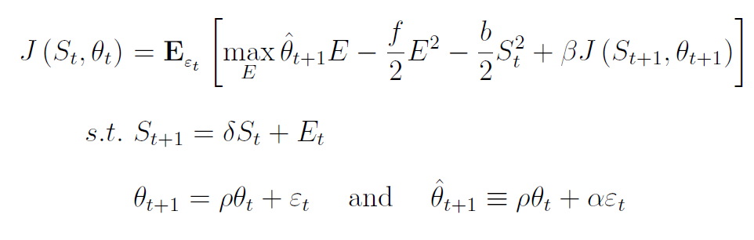

Appendix: The Linear Quadratic Model
Model: Bellman equation & equations of motion:
emission benefits stock damages
J: Value function - solved by linear-quadratic function
$f:$cost convexity & $b:$ damage convexity
$θ_{t}:$ technology (lower = better = easier to get by without emissions)
$S_{t}:$ Carbon stock in the atmosphere (measured w.r.t zero MD point)
$ε_{t}:$ innovation (mean zero iid shock, only share $α$ adopted in present)
$ρ$: persistence of technology shocks
Partial adoption in present period

Slide 33

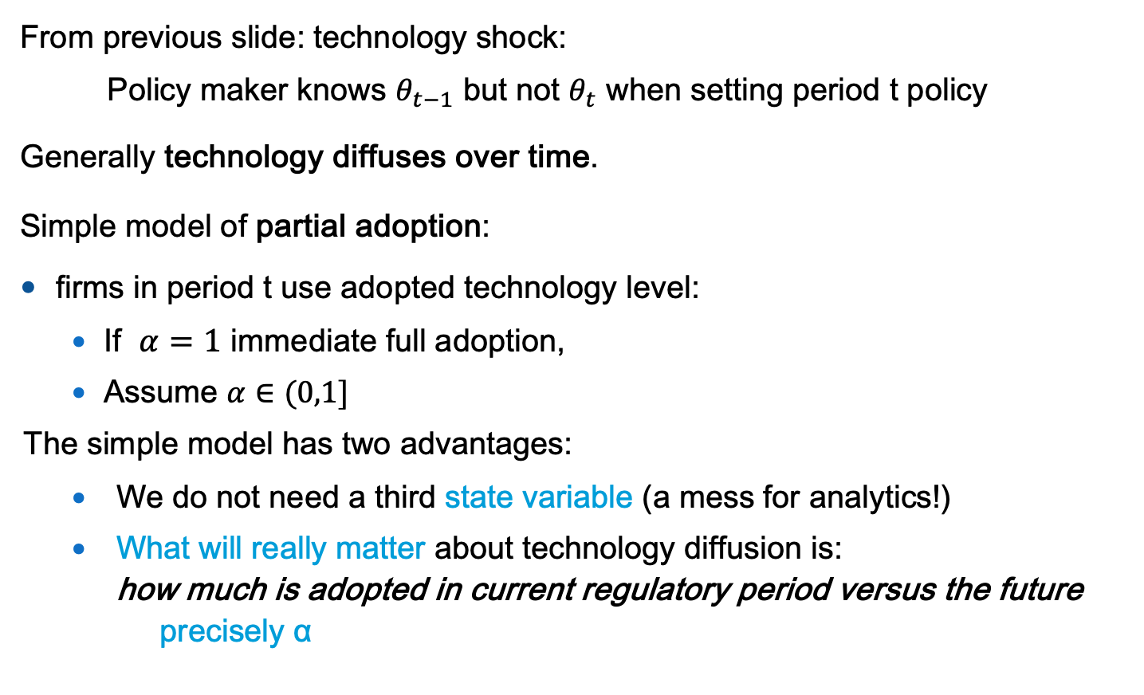
Appendix: Partial/Slow Technology Adoption
From previous slide: technology shock:
Policy maker knows $θ_{t−1}$ but not $θ_{t}$ when setting period t policy
Generally technology diffuses over time.
Simple model of partial adoption:
firms in period t use adopted technology level:
  If $α=1$ immediate full adoption,
  Assume $α∈(0,1]$
The simple model has two advantages:
  We do not need a third state variable (a mess for analytics!)
  What will really matter about technology diffusion is:
  how much is adopted in current regulatory period versus the future
  precisely α
Notes:
Emissions price to be constant. If certificate price increases I have to allow more emissions per certificate to keep price constant
Consider expressing in paper also for normalizing in terms of a=1.

Slide 34


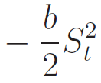
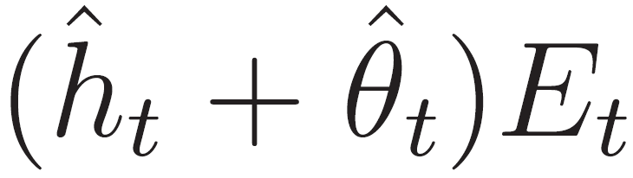

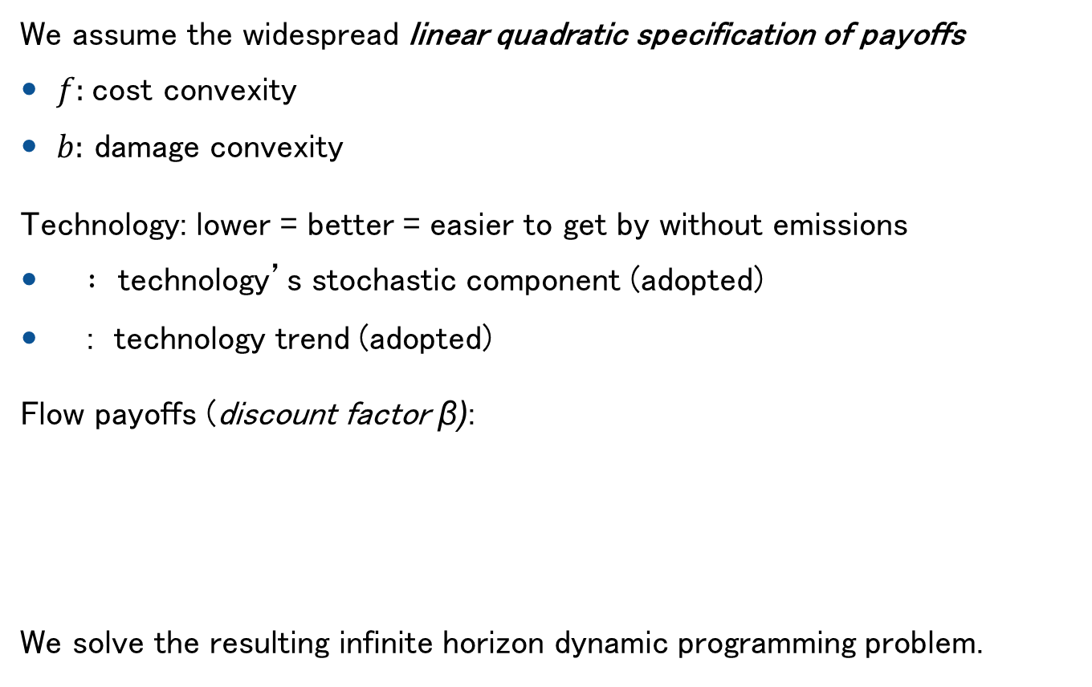
More Detail: technology trend plus stochastic deviation
We assume the widespread linear quadratic specification of payoffs
$f:$cost convexity
$b:$ damage convexity
Technology: lower = better = easier to get by without emissions
$:$ technology’s stochastic component (adopted)
: technology trend (adopted)
Flow payoffs (discount factor β):
We solve the resulting infinite horizon dynamic programming problem.
emission benefits stock damages

